Slide 1

Basic Database ER Model

Slide 2
Semantic Modeling
A class of data models
Conveys semantic meaning
Implements databases more intelligently
Support more sophisticated user interfaces (SQL queries, forms & reports)
Research started in 1970s and early 1980s
Other names are data modeling, E/R modeling, E-modeling
CS204 Database System

Slide 3
Top-Down Methodology
Design methodologies that are based on semantic modeling ideas are often referred to as Top-Down methodologies, because they start at a high level of abstraction with real world constructs or entities and finish at the low level of abstraction represented by a specific concrete database design
CS204 Database System

Slide 4
Chen E/R Model
Chen in 1976 introduced the E/R model
The E/R model allows us to sketch the design of a database informally.
Designs are pictures called entity-relationship diagrams.
Fairly mechanical ways to convert E/R diagrams to real implementations like relational databases exist.
CS204 Database System

Slide 5
Database Development & DBA
Requirements
Analysis
Requirements
Specification
Natural Language
Conceptual
Design
Conceptual
Model
Informal
Logical
Design
Relational
Model
Formal
DBMS-independent
Database
Building
DBMS-specific
Database
Physical/ DBA
Operation, Mainte-
nance, & Tuning
Evolving
Database
CS204 Database System

Slide 6
Database Development …
Requirements Analysis
  Collect and Analyze the requirements of the users, e.g., Functional Specification, Prototyping.
Conceptual Design
  Design a conceptual model (schema), e.g., ER model, ER Design, ER Mapping.
Logical Design
  Translate the ER model into a relational model (schema), DDL Scripts (e.g., ER Mapping to DDL)
  Normalization
Database Building
  Build the database and write application programs for specific DBMS & S/W Appls/ Tools.
Operation, Maintenance & Tuning
  Use/ Training, Installations, maintain and “tune” the database.

Slide 7
Goals for Conceptual/ Logical Design
Simplicity
  Users should understand the design
  Data model should match users’ conceptual model
  Queries should be easy and intuitive to write
Expressiveness
  Include enough information to answer all important queries
  Include all relevant data (without irrelevant data)
  Design must be within well-defined scope
Performance
  An efficient physical design (DBA) should be possible

Slide 8
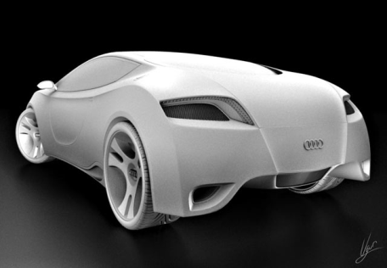
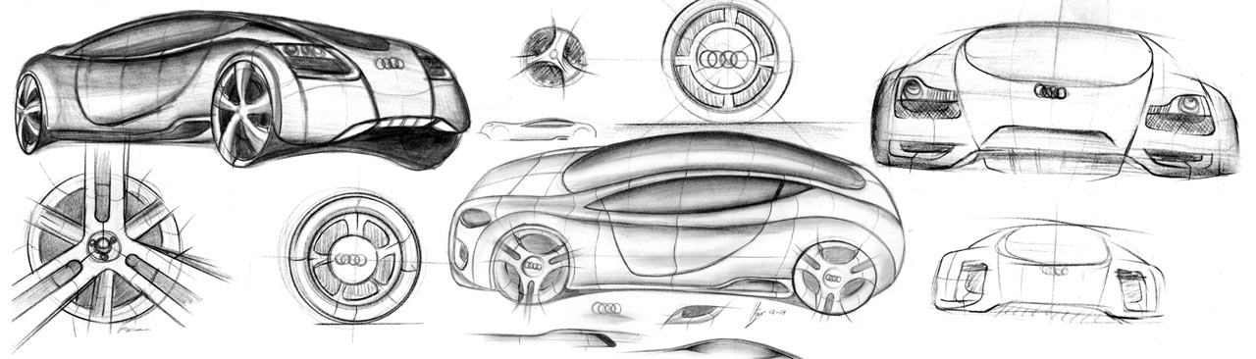
Conceptual Model
Highest conceptual grouping of ideas
  Data tends to naturally cluster with data from the same or similar categories relevant to the organization
The major relationships between subjects have been defined
  Least amount of detail

Slide 9
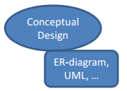






Conceptual Model…
Conceptual design
Entity-Relationship (ER) Modeling
  Entities - “things” in the real world
– E.g. Car,Account, Product
Car Account Product
Attributes – property of an entity, entity type, or
relationship type
Car Color
– E.g. color of a car, balance of an account, price of a product
Relationships – between entities there can be relationships, which also can have attributes
– E.g. Person owns Car
Person Car
owns

Slide 10

Conceptual Model to Reality
CS204 Database System

Slide 11
Systems Development Life Cycle.
Most systems development efforts follow a classical
Systems Development Life Cycle.
1. Project Identification - preliminary analysis of needs. Feasibility study of project.
2. Project Initiation and Planning - identifies possible approaches to solving the business need.
3. Analysis - identify the functional specifications for the business needs - continue to confirm that the project is feasible.
4. Logical Design - detailed functional specifications in the form of screen designs, report layout designs, data models, processing rules, etc.
CS204 Database System
Notes:
Project Identification means Feasibility Study of Project, before starting project
Analysis Includes Requirements

Slide 12
Systems Development Life Cycle.
5. Physical Design - programming, development of physical data structures, redesigning parts of the organization to support the new system.
6. Implementation - sometimes includes testing or testing may be part of physical design. Includes a plan to cut over to the new system. (Process of moving idea/ design from concepts to reality)
7. Maintenance - continued modification of the system as the firm's needs change.
CS204 Database System
Notes:
Implementation: DDL script, DML with datasets (Database State)

Slide 13
Three-Schema Architecture.
This is the concept that there are different levels or views of the data that the firm uses.
Level 0--Reality. This is the actual real data that managers use.
Level 1--Conceptual Schema - also called a Conceptual Model.
  This model is developed during the analysis stage of system development.
  Typically this is some type of diagramming model of the data and the relationships among the data. It is an abstractions of reality to focus on the data the firm uses for specific applications.
  Entity-Relationship Diagrams capture overall structure of the organization's data (Purpose: Storing Data)
CS204 Database System

Slide 14
Three-Schema Architecture.
Level 2--External Schema -- also termed a Logical Model.
  This model is developed during the design stage and represents the actual implementation of the conceptual model with a specific DBMS product.
  This includes table design and the application of rules for Normalization of data and translating conceptual model into relations.
Level 3--Physical or Internal Schema.
  This is created during the physical design and implementation phase.
  It includes the actual storage of data, creation of files that comprise the database including indexes and other structures

Slide 15
For Logical Design
Translate an ER schema into a relational schema.
  Entity
  Relationship
  Attribute
  Subtype
Normalization
  To ensure you have a “good” design (Testing of your model).
CS204 Database System

Slide 16
SUMMARY OF ER-DIAGRAM NOTATION
Symbol
Meaning
ENTITY TYPE
WEAK ENTITY TYPE
RELATIONSHIP TYPE
IDENTIFYING RELATIONSHIP TYPE
ATTRIBUTE
KEY ATTRIBUTE
MULTIVALUED ATTRIBUTE
COMPOSITE ATTRIBUTE
DERIVED ATTRIBUTE
TOTAL PARTICIPATION OF E₂ IN R
CARDINALITY RATIO 1:N FOR E₁:E₂ IN R
STRUCTURAL CONSTRAINT (min, max) ON PARTICIPATION OF E IN R
E₁
R
E₂
E₁
R
N
E₂
R
(min,max)
E
Notes:
1 Means Any One. N means N>=0

Slide 17
Example COMPANY Database – 1
Requirements of the Company (over) simplified:
  The company is organized into DEPARTMENTs.
  Each department has a name, number and an employee who manages the department.
  We keep track of the start date of the department manager.
  Each department controls a number of PROJECTs.
  Each project has a name, number and is located at a single location.

Slide 18
Example COMPANY Database – 2.
  We store each EMPLOYEE’s social security number, address, salary, gender, and birthdate.
  Each employee works for one department but may work on several projects.
  We keep track of the number of hours per week that an employee currently works on each project.
  We keep track of each employee’s direct supervisor.
  Each employee may have a number of DEPENDENTs.
  For each dependent, we keep track of their name, gender, birthdate, and relationship to employee.
Notes:
Oracle schema of scott has similar artifacts of this requirement. Using demobld.sql oracle schema file

Slide 19
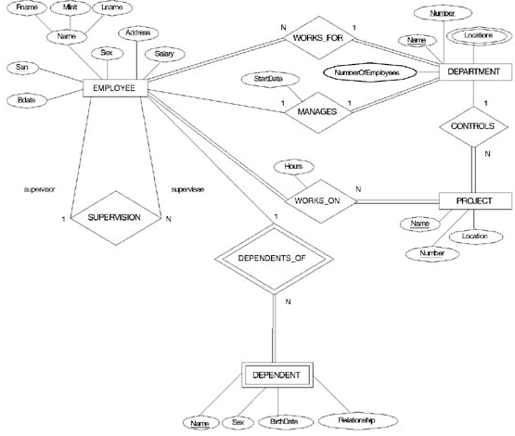
We will aim to Draw ER DIAGRAM FOR THE COMPANY DATABASE

Slide 20
End
CS204 Database System

